Slide 1


Docker in action

Slide 2
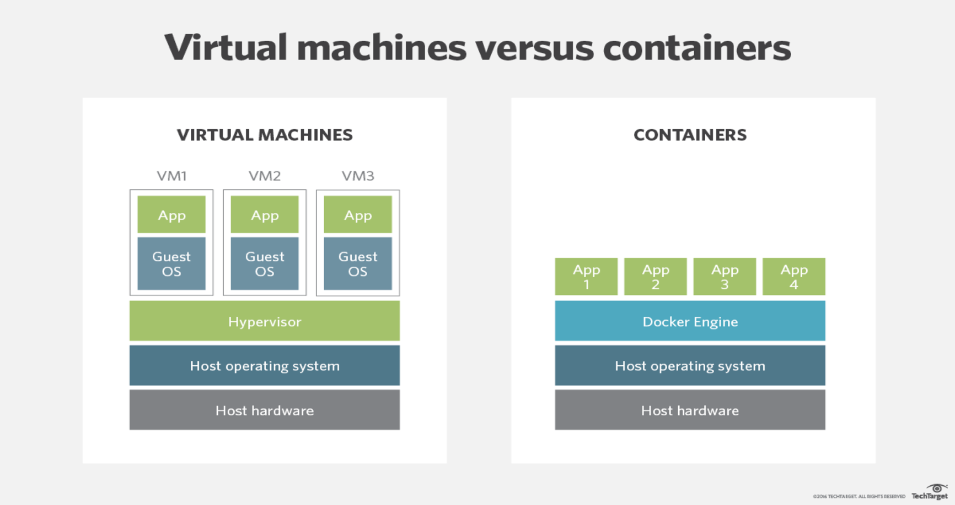
Docker in action
VMs vs containers
Containers and VMs are similar in their goals: to isolate an application and its dependencies into a self-contained unit that can run anywhere.

Slide 3
Docker in action
(OCI)
Containers
vs
Dockers

Slide 4
Docker in action
Linux containers
vs
Windows containers

Slide 5

docker in action
https://12factor.net/

Slide 6
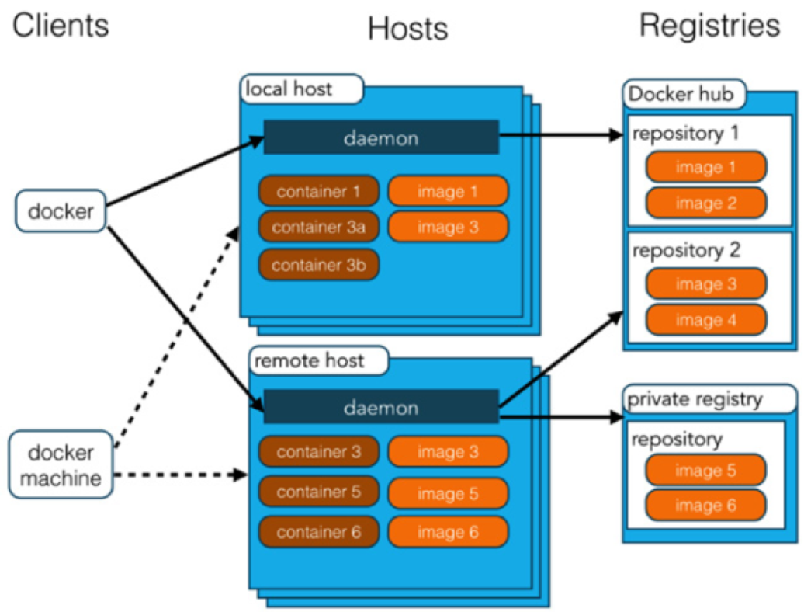
Docker in action
Docker architecture
Docker images | A recipe or template for creating Docker containers. It includes the steps for installing and running the necessary software.
Docker container | Like a tiny virtual machine that is created from the instructions found within the Docker image originated
Docker client | Command-line utility or other tool that takes advantage of the Docker API to communicate with a Docker daemon
Docker host | Physical or virtual machine that is running a Docker daemon and contains cached images as well as runnable containers created from images
Docker registry | A repository of Docker images that can be used to create Docker containers. Docker Hub is the most popular social example of a Docker repository.
Docker machine | A utility for managing multiple Docker hosts, which can run locally in VirtualBox or remotely in a cloud hosting service such as Amazon Web Services, Microsoft Azure, or Digital Ocean.

Slide 7
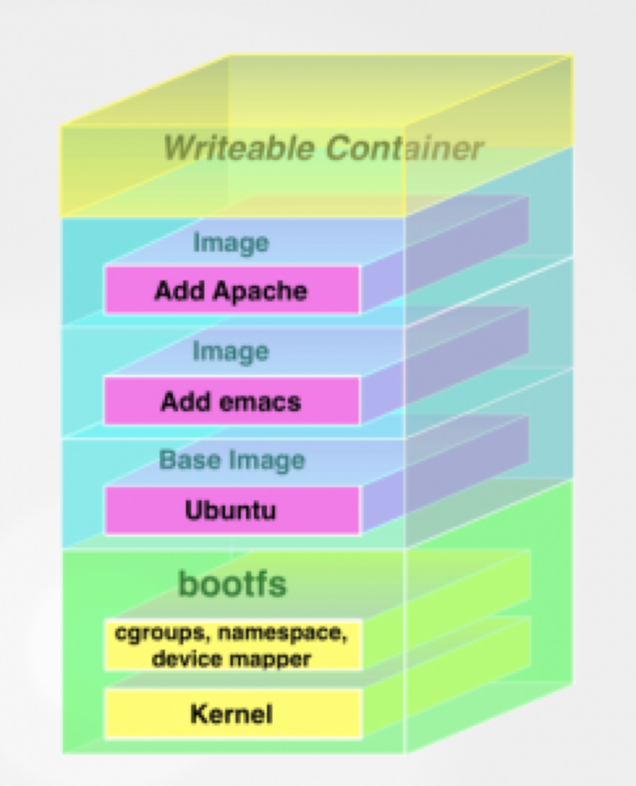
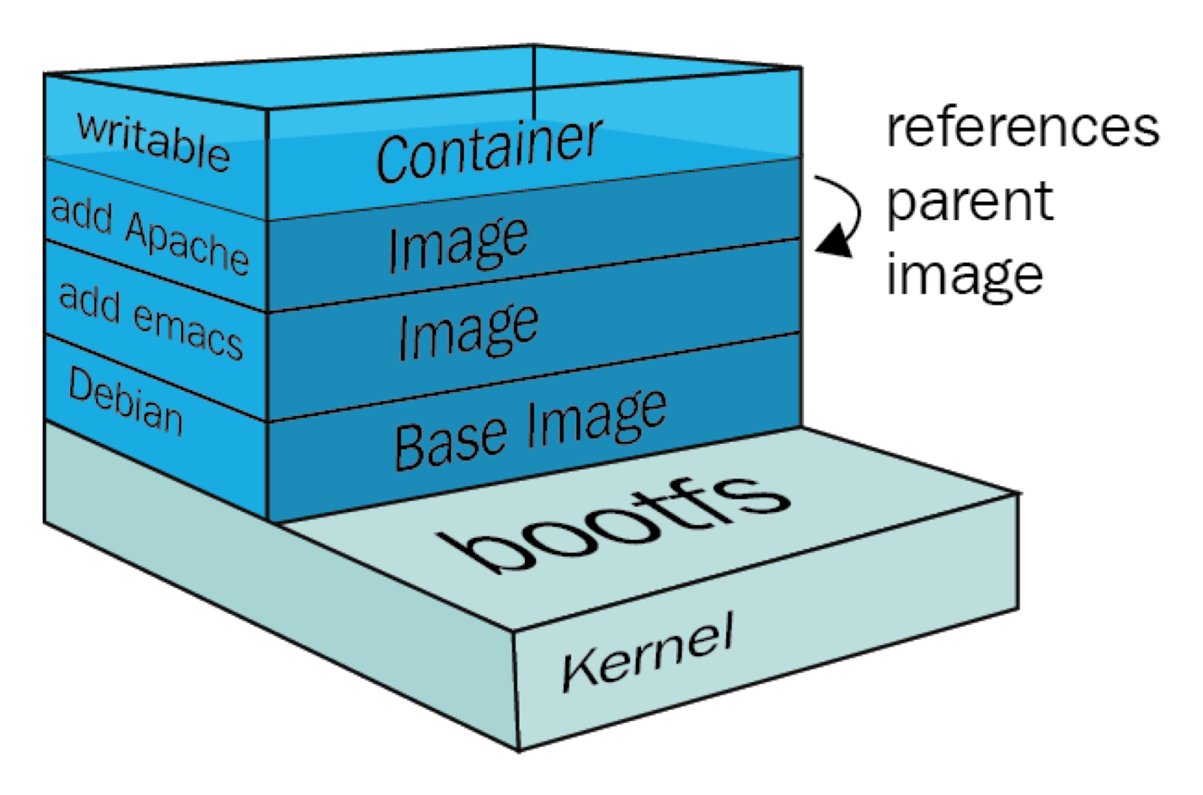
docker in action
Docker layered file system
https://collabnix.com/understanding-docker-container-image/
https://medium.com/docker-captain/docker-basics-f1a06fde18fb

Slide 8
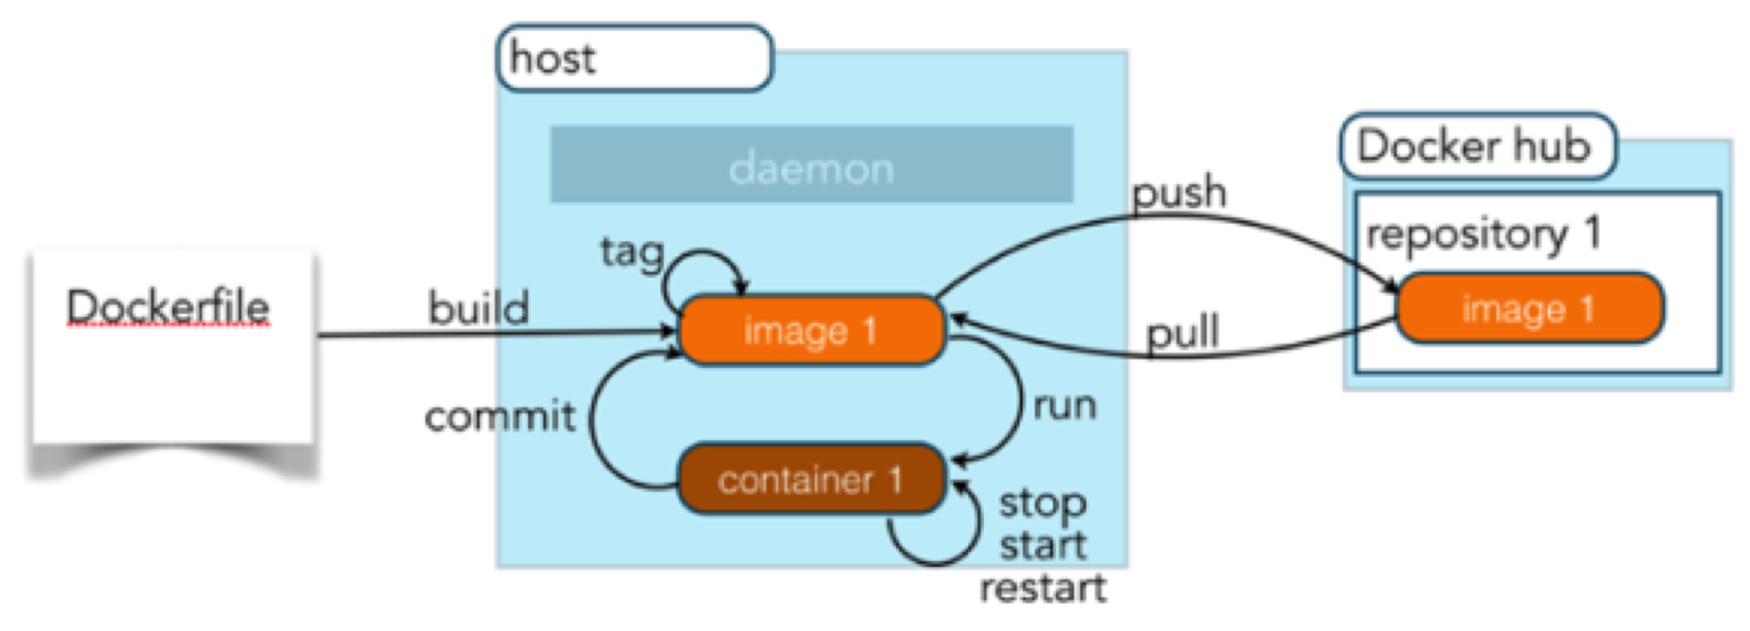
docker in action
Docker workflow

Slide 9
docker in action
Docker usages
Provisioning backing services during development phase
Development environment for application code
Run tests
DevOps application
Create full local and testing environments
Deployment/Packaging solution

Slide 10
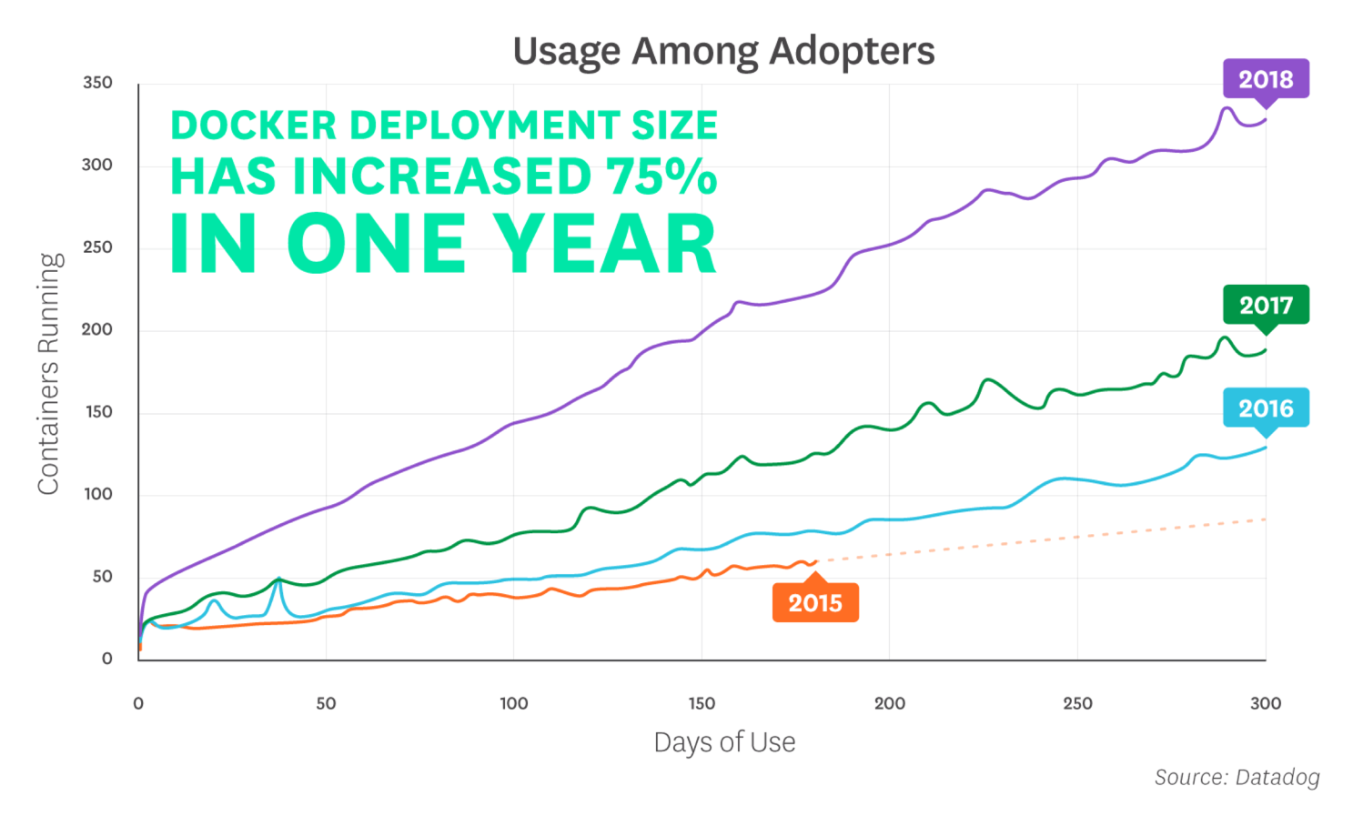
docker in action
Docker adoption trend
https://www.datadoghq.com/docker-adoption/

Slide 11
docker in action
Software List request from E&L
Current way
VS 2017
VS Code
git 2.20.1
mongo 3.4.19
mongo 2.6.12
mongo 1.8.0
rabbitmq 3.7.10
SQL Server 2017
node v10.15.0
node v9.4.0
node v8.2.0
node v7.2.0
node v5.1.1
node v4.4.4
...TO BE CONTINUED…
Deployment/Packaging solution
Docker way
VS 2017
VS Code
git 2.20.1
Docker Desktop

Slide 12
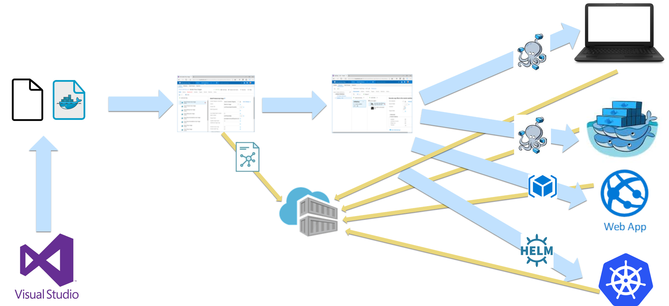
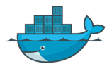
Docker Engine
docker in action
CI/CD
TFS Source control
TFS Build
TFS Release
Docker Swarm
C#
Dockerfile
Docker Image
Azure Container Registry

Slide 13
Docker in action
Demo

Slide 14
Docker in action
2003
2007
2013
2017
WOA
Mac OS
Virtualbox Windows
Windows
Mac OS
Mac OS
cassini
.net framework 1.1
WebForms
access
—————————————————————
VisualStudio
Manual Deployment
—————————————————————
.bat file
browser bookmark
cassini
.net framework 1.1
WebForms
access
—————————————————————
VisualStudio
Manual Deployment
—————————————————————
.bat file
browser bookmark
xsp4
mono
WebForms
sqlite
—————————————————————
VisualStudio
Manual Deployment
—————————————————————
.command file
browser bookmark
docker engine
docker container
kestrel
.netcore2.0
WebApi
sqlite
—————————————————————
VisualStudio
Github
Travis
Canister
Heroku
docker-compose
—————————————————————
browser bookmark

